Slide 1
Using Puppet and DSC to Report on Environment Change
James Pogran
Senior Software Engineer - Windows Puppet
Notes:
Good afternoon everyone
I’m James Pogran, a Senior Software Engineer on the Windows team here at Puppet
I’m going to talk to you about using Puppet and DSC to report on Environment change

Slide 2
> Get-Agenda
Importance of Change Reporting
How DSC does Change Reporting
How Puppet improves Change Reporting
Notes:
Today we’re going to talk about the importance of change reporting
Then we’re going to review how DSC tracks and reports change
Lastly we’ll see how Puppet improves change reporting and makes things easier
But before that…who am I?

Slide 3
> whoami
At Puppet for over 2 years
Puppet Modules
Core Agent and Installer
PDK
Puppet VS Code extension
Notes:
I’ve been working at Puppet now for over 2 years, on the Windows team.
I’ve worked on Puppet Modules, mostly focused in Windows, the most recent of which has been the IIS and DSC modules.
I’ve also worked on the Core Agent, the Puppet Agent installer
Most recently I’ve helped with the Puppet Development Kit and co-authored the Puppet VSCode extension with Glenn Sarti

Slide 4
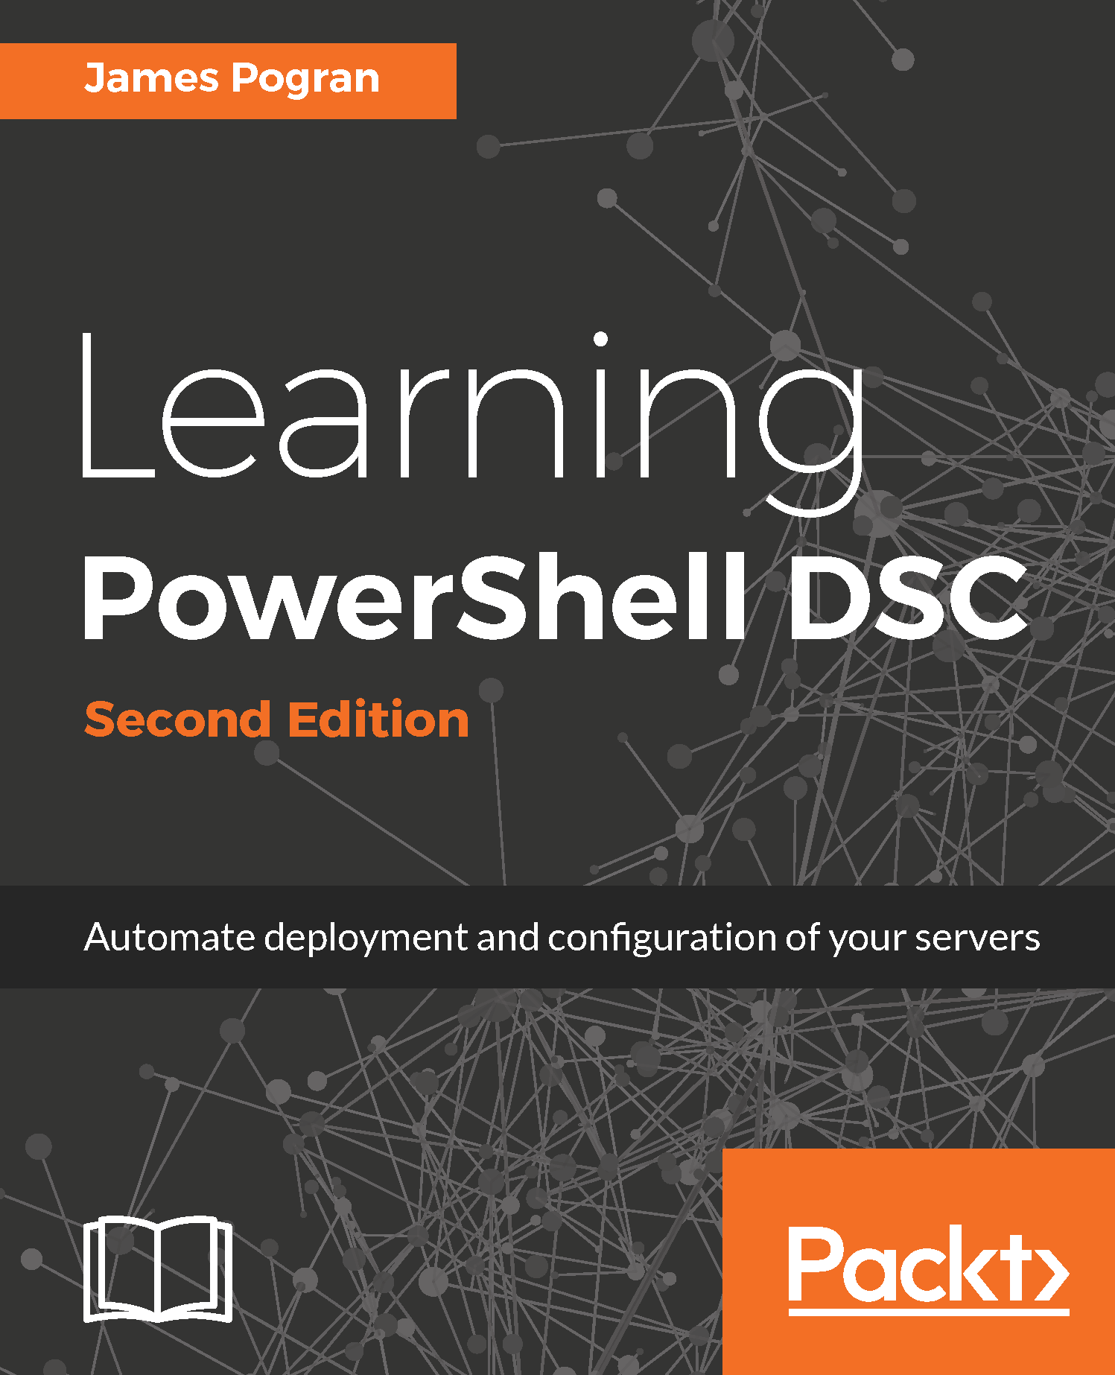
> whoami
http://jamespogran.com
@ender2025
Notes:
More relevant to todays talk is my past experience with DSC.
I’ve been working in the industry for over 15 years, 8 of those writing Windows automation for a large managed service provider.
2 of those years I was crazy enough to use DSC to deploy apps to production, on v4.0 no less!
You may notice the name up there in the corner. From those experiences I wrote a book called Learning PowerShell DSC, which is in it’s second edition. At the end of the talk they’ll be a some copies of my book outside this room

Slide 5
Change Reporting
Notes:
Show of hands, how many of you are have used DSC before? Using Puppet? Using Puppet and DSC?
Well, that was a good showing, most/some/everyone here has used Puppet and/or DSC in some form or fashion.
So you at least know Puppet and DSC ensure a desired state (see what I did there?) on servers, but why is that important?

Slide 6
Change Reporting
Why is it important?
Notes:
You’re here at this conference, so you know something about DevOps practices and Continuous Delivery.
That they reduce the risk of change by making many small, incremental changes instead of a few “big bang” changes.
Changing more often proves your ability to test and successfully push out changes environment
It forces you to automate and streamline these processes
But How do you know those changes are successful? How do you know what you intended to do, was done?
This is the important of tracking change

Slide 7
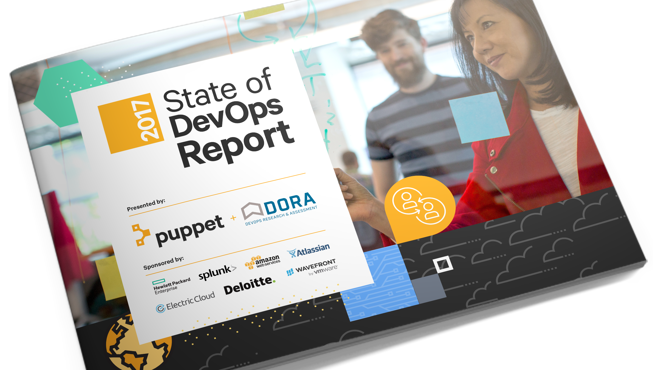
Notes:
You don’t have to take my word for it. We publish this thing called the State of DevOps Report.
It’s the industry standard report on what practices make successful devops implementors
In the report Puppet found:

Slide 8
Change Reporting
Knowledge is power
Notes:
That knowledge of how things are performing is as valuable as how things are not performing
In the Devops report we measured IT performance along two main dimensions: throughput of code and stability of systems
And we rated respondents based on how they performed in these dimensions. High performers scored high, low performers scored low

Slide 9
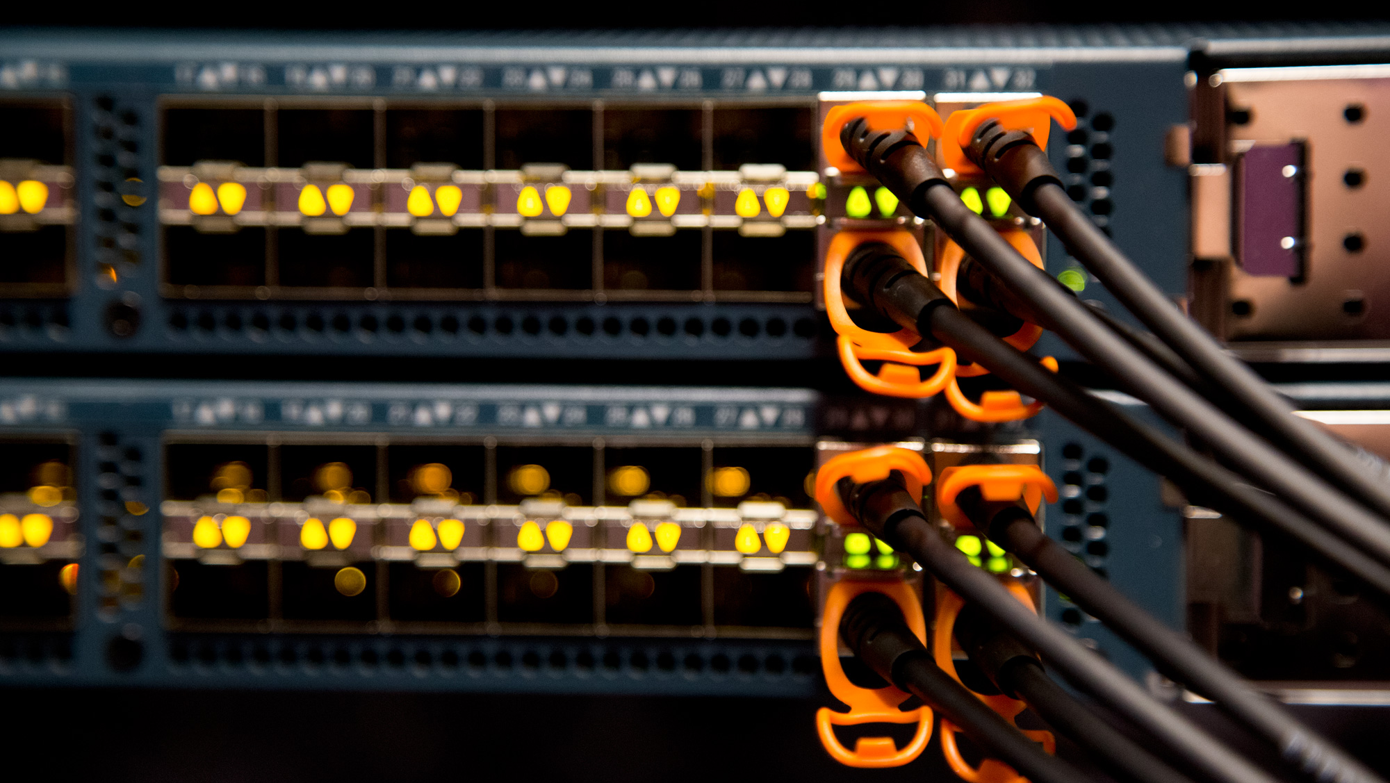

46x
440x
More frequent
Code deployments
Faster lead time from commit to deploy
That’s the difference between multiple times per day and once a week or less.
That’s the difference between less than an hour and more than a week.
Notes:
Throughput is measured by how frequently a team is able to deploy code and how fast it can move from committing code to deploying it.
In 2017, we found that the high performers have 46 times more frequent code deployments.
That’s 46 times more change that the low performers that they’re handling without business interruption
This lead them to 440x faster code deploys from commit time. That’s time saved, compounded

Slide 10
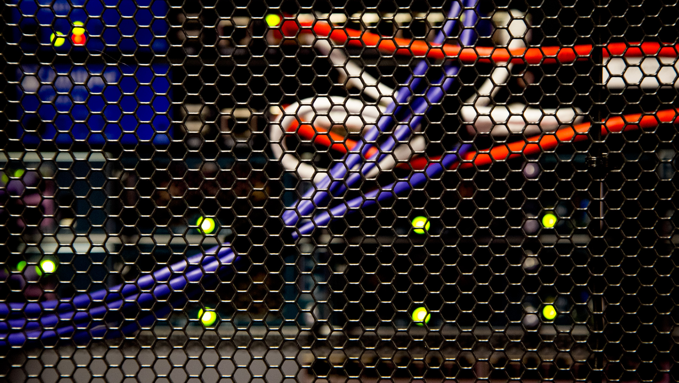
96x
5x
faster mean time to recover from downtime
lower change failure rate
That means high performers recover in less than an hour instead of several days.
That means high performers’ changes fail 7.5% of the time instead of 38.5%.
Notes:
We also measure on stability of systems
Stability is measured by how quickly the system can recover from downtime and how many changes succeed, versus how many fail.
High performers were 96x faster to recover from downtime
And they had 5x lower change failure rate

Slide 11
Change Reporting
Time spent looking is time wasted
Notes:
So that says why it's important, but how do you get there.
You want to get the most out of your time and effort
Doing more with less sounds like a cliché, but it’s a fact of life for any sysadmin or developer
Time and resource constraints require flexibility and resourcefulness
You don’t have time to mess around, you need to know what is happening so you can get things working fast

Slide 12
Change Reporting
It should be automatic
Notes:
You have better things to do than look at through log files yourself, on many different servers, with different access methods, accounts, etc
Seeing changes across your environment in an easily accessible manner reduces the amount of time you spend verifying the change.
You don't have to manually check the state because the data is already collected for you.

Slide 13
Change Reporting
It needs to be recorded
Notes:
And lastly, history needs to be kept (next slide)

Slide 14
Those who cannot remember the past are condemned to repeat it.
- George Santayana
Notes:
All of this is ephemeral unless you keep a record
Being able to pinpoint not only that something changed, but *when* it changed is a huge step toward gaining true control over your environment.
Knowing when something changed is just as important as knowing what changed. If you're able to find out when the change happened, correlation to other events becomes easier and reduces the amount of time spent troubleshooting.
Next slide

Slide 15
DSC Change Reporting
Notes:
Now that we know what change reporting is and why it’s important, lets go examine how DSC does things

Slide 16
PowerShell DSC
A primer
Notes:
How DSC works is a topic worthy of it’s own talk, which we don’t have time to get into here today
In short is a declarative platform used for configuration, deployment, and management of systems.

Slide 17
PowerShell DSC Primer
DSC Configurations
DSC Resources
Local Configuration Manager (LCM)
Notes:
It consists of 3 primary components:
DSC Configurations: Which are declarative PowerShell scripts that are comparative to Puppet manifests. They list out the things to ‘do’
DSC Resources: PowerShell code that is responsible for testing and setting state on target nodes
LCM: The agent installed on every host that executes the DSC Configurations
So what does it look like?

Slide 18
Notes:
Here is an example DSC Configuration. I’ll be using it later to show how DSC reports on change in our demo, for now we’re using part of it it to review structure.
It sets up a webserver to use IIS and also creates a website.
We start with the configuration declaration, which is analogous to a class declaration in Puppet
then (NEXT SLIDE)

Slide 19
Notes:
…then the DSC Resources we need are listed
These are sorta like include statement in Puppet, but are evaluated sooner in the compilation process
(NEXT SLIDE)

Slide 20
Notes:
…then the listing of what state should be present on the server.
If you notice the semi-familiar format to most of what DSC uses, it isn’t an accident. Bruce Payette (author of PowerShell) said Microsoft was inspired by Puppet when they started implementing DSC
So we’ve seen in a short time how we create a DSC Configuration, but how does DSC effect these changes?

Slide 21
DSC Deployment Modes
DSC Push Mode
One time execution of DSC Configurations
Does not distribute DSC Resources
Does not store results from DSC execution
Notes:
DSC deploys DSC Configurations (changes) to target nodes two ways
Push Mode deployment directly executes a DSC Configuration on a target node, asynchronously or synchronously, and logs results to the Event log
You are responsible for ensuring that all the DSC Resources needed are on the target node, DSC Push mode will not do that for you.
While you can execute DSC Configurations using Push Mode on many many servers at once, it quickly becomes apparent you need something that will do this more intelligently than a simple scheduled task.
(next slide)

Slide 22
DSC Deployment Modes
DSC Push Mode
One time execution of DSC Configurations
Does not distribute DSC Resources
Does not store results from DSC execution
DSC Pull Server
Stores and executes DSC Configurations
Distributes DSC Resources
Maintains registry of nodes
Stores data from each DSC execution
Notes:
The second way DSC deploys to target nodes is the DSC Pull Server
The Pull Server picks up where Push Mode leaves off by being a central repository for all DSC Configurations and DSC Resources.
It handles both distribution of DSC Configurations and DSC Resources as well as maintaining a list of allowed target nodes to execute DSC Configurations on.
It also keeps track of which target nodes need which DSC Configuration, which is a nice feature if a little klunky to implement in practice.
The DSC Pull Server stores results (the changes) from the DSC execution, which is what we have been looking for
So what type of change events does DSC log?

Slide 23
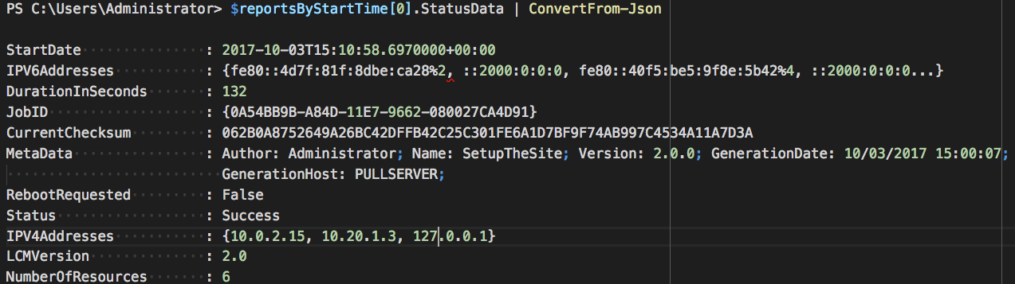
DSC Change Event Types
Notes:
Here is a screenshot of the results from a DSC run on a target node
I’m skipping for the moment how to get this information so that we can cover what information we do get.
There’s a fair bit of data returned, along with a lot of metadata, but for the purpose of determining what changed or did not change on a target node, there are only two change data points reported by DSC
DSC will log a general Status of Success or Failure, and this represents the whole DSC run on a target node. If one part fails, then the run is a failure, even if the rest of the DSC Configuration runs successfully.

Slide 24
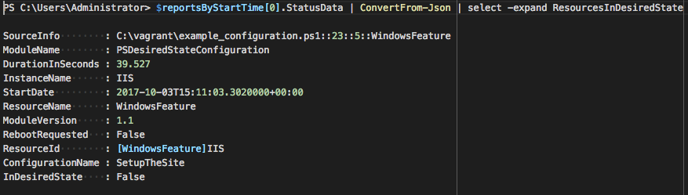
DSC Change Event Types
Notes:
The other data point we are interested in is the state returned by each DSC Resource
It will list out each DSC Resource in your Configuration, and whether it determined if the target node was in the desired state or not.
This information you get from a DSC run is lacking a certain important point that we'll get to in a moment
DSC records whether a DSC Resource changed state or not, but does not record which part of a DSC Resource changed.

Slide 25
PowerShell DSC
Ok, really, how do we get the change data?
Notes:
So how do we actually get that out of DSC?
DSC Pull Server*:
Does not have a user console or web page to view results
Does not have a visual representation of target node status ‘at a glance’
Does not have detailed information on granular change status
[*]DSC Pull Server in Azure has gotten some love recently and does show some of this information, but this is not available for on-premise solutions yet
What DSC Pull Server does have is a reporting service that exposes a REST API you can query

Slide 26

Getting DSC Change Events
Query change events using REST API
Use any script/command capable of web calls
PowerShell to the rescue! Maybe…
Notes:
The reporting service allows you to query it to get the change events for all target nodes.
This gives you a great deal of flexibility in how to get the data you want. You can use PowerShell, or basically anything that can call web URLs.
The flexibility comes with cost however, as you have to write the queries yourself. It’s ODATA, so if you’re familiar with that, that’s great. If not, there’s some learning curve there.
PowerShell to the rescue! But, you’re still writing the code yourself.
You’re responsible for sorting and formatting as well, and finding a way t putt it into a format that will present the information in a useful manner. Let's see how its done

Slide 27
Demo
Getting DSC Change Events

Slide 28
Puppet Change Reporting
Puppet & DSC Together
Notes:
We just covered what change events DSC provides, and how to get them. We’ve seen some good data and some places to improve.
Now we’ll cover how Puppet reports on change in your environment.
Then we’ll see in action how Puppet combines what it knows with the information DSC surfaces for powerful change reporting

Slide 29
Puppet
A Primer
Notes:
Well, we made it this far into a talk at PuppetConf and haven’t done anything with Puppet yet. Dunno if that’s a good or bad thing, but I guess I’ll found out soon enough
As with DSC, how Puppet works is a topic worthy of it’s own talk, and you're at a conference full of talks about Puppet, and fortunately there’s a wealth of documentation and support out there for you to learn Puppet, so I'll keep the primer brief.
They’ll be some links at the end of the deck to find how-tos, docs, and learning resources for Puppet.

Slide 30
Puppet Primer
Puppet Manifests
Puppet Modules
Puppet Agent
Notes:
It consists of 4 primary components:
Puppet Manifests: A DSL that lists out the things to ‘do’
Puppet Modules: Ruby code that is responsible for testing and setting state on target nodes
Puppet Agent: The agent installed on every host that executes the Puppet manifests
Puppet Server: Does lots of things
So what does a puppet manifest look like?

Slide 31
Notes:
Here is the example DSC Configuration we saw before, converted to a Puppet manifest, doing the same thing I explained earlier.
We start with the class declaration, then

Slide 32
Notes:
…the listing of what state should be present on the server.
You’ll see that the Puppet DSL is simple concise syntax that makes sense when you read it.
Notice also that we’re using DSC Resources directly inside our manifest. All we had to do to make that happen is to add a few letters and change a few symbols.
You can take the time you already invested in DSC, and build upon it with a few text edits by using puppet.
But how does Puppet effect these changes?

Slide 33

Puppet Enterprise Deployment Modes
Stores and distributes manifests, modules and files
Maintains a registry of nodes
Stores data from each Puppet execution
Notes:
During a Puppet run, Puppet compares the current state of each property on each resource to the desired state for that property, as defined by the node’s catalog.
If Puppet successfully compares the states and the property is already in sync (in other words, if the current state is the desired state), Puppet moves on to the next resource without noting anything.
Otherwise, it attempts some action and records an event, which appears in the report it sends to the Puppet master at the end of the run.

Slide 34
Puppet Change Event Types
Failure
Corrective Change
Intentional Change
Corrective no-op
Intentional no-op
Skip
Notes:
So right away, we get more information out of the box from a Puppet run than we do with DSC
But for the purposes of our talk though, we only need to cover some of them
(next slide)

Slide 35
Puppet Change Event Types
Failure
Corrective Change
Intentional Change
Corrective no-op
Intentional no-op
Skip
Notes:
Failure - Means a property was out of sync; Puppet tried to make changes, but was unsuccessful.
Corrective change – Means Puppet found an inconsistency between the last applied catalog and a property’s configuration, and corrected the property to match the catalog
Intentional change – Means Puppet applied catalog changes to a property.

Slide 36
Puppet
Property based change events
Notes:
Notice the part when I was talking about corrective and intentional change? I said property based?
DSC only reports whether the DSC Resource needed to change state, not what actually changed state inside.
If the File DSC Resource changed the state on your server, you would want to know whether the content needed to be changed or the permissions of the file. One means the website was updated, the other possibly means a security issue!
Puppet would have recorded this
So what do we have to build in order to view these changes in Puppet?

Slide 37
View Puppet Change Events
PE Console to view results
Visual representation of target node status
Detailed information on change status
Notes:
Nothing! We do the work for you! That’s it! Presentation done, we can all go home now. Drop mic… Well you probably want to see it.
So, PE provides a central console you can use to look at all the change events in your environment.
You get a visual representation of your entire environment’s health, or a specific server
All events are automatically logged for you and shipped to the PuppetDB, where it’s available for view in the PE console or through custom queries

Slide 38
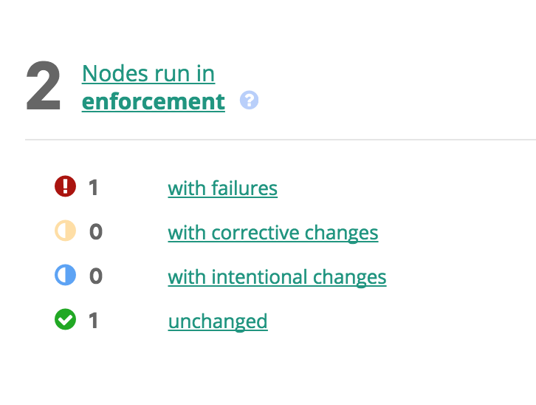
Puppet Change Reporting
Entire environment at a glance
Notes:
You'll get a view of all the nodes in your environment, with status on all the different changes happening right up front.
Notice all the types of change we just talked about are right upfront

Slide 39
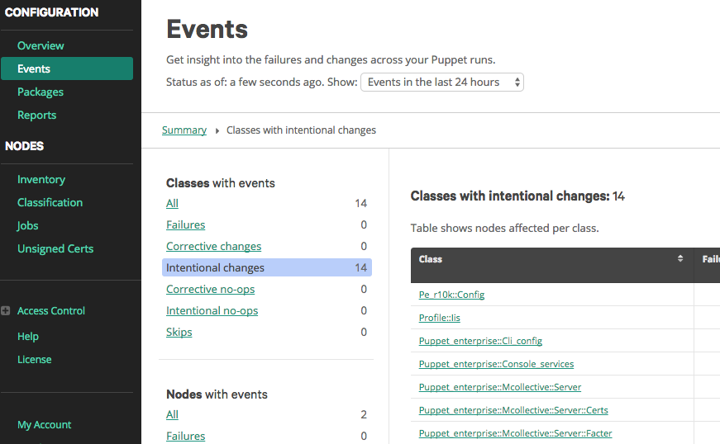
Puppet Change Reporting
Event summary
Notes:
You'll get an event summary page with more granular detail about each change.
Everything is clickable to drill down further in detail
Again Notice all the types of change we just talked about are right upfront

Slide 40
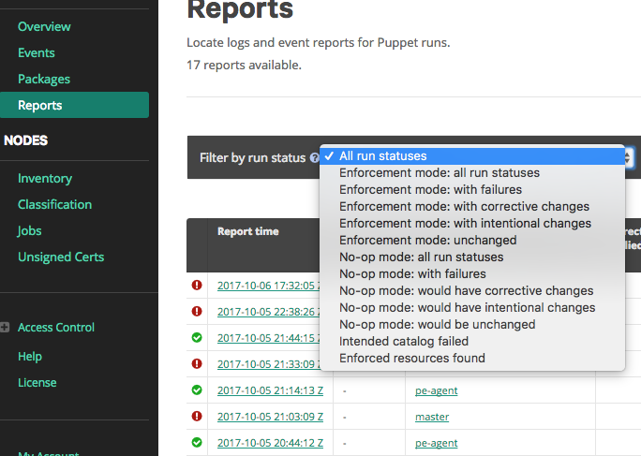
Puppet Change Reporting
Granular filtering
Notes:
You can use the Report section to filter your information to find exactly what you're looking for
There are a bunch of built-in queries and filters to use,
and if your use case isn’t there you can drop down to PQL to query directly for the information you need
So now, lets look at our DSC example we covered before,
but this time in a Puppet setup

Slide 41
Demo
Puppet & DSC together
Notes:
So now, lets look at our DSC example we covered before,
but this time in a Puppet setup

Slide 42
> Get-Summary
Puppet provides
A single way to view change events across all nodes without manual effort
Reports for most use cases built in
Queryable API provides customized reporting
Information collated for you without have to do extra configuration
Notes:
So we began this talk by defining change and reviewing why change is important
Then we looked at how DSC and Puppet view and report on change
We've seen that Puppet provides a single way to view change across your entire environment, providing reports in formats you'll mostly likely need, but also providing customized reports if necessary
All without extra work from you

Slide 43
> Get-Help -full
Code available at https://github.com/jpogran/presentations/puppetconf/puppetconf2017
Beginners guide to install PE: https://puppet.com/blog/how-get-started-puppet-beginners-guide
Windows on the Puppet blog: https://puppet.com/blog-tags/windows
Glenn Sarti – How to Not Freak out When you Start Writing Puppet Modules for Windows https://youtu.be/9A2-_nPrqfs

Slide 44
Questions?
Thanks for listening!
Notes:
Just a reminder a few copies of my book are available at the table outside this room

